Slide 1
Course Code:CSC402A Course Title: Web Architecture and Application Development
Course Leader:
Kishore S.M.
kishore.cs.et@msruas.ac.in

Slide 2
Objectives
After completing this lecture, the student will be able to
Analyze servlets and its types
Analyze JSP technology

Slide 3
Contents
Java Servlets
JSP

Slide 4
Servlets
Servlet technology allows to develop Java applications that generate web content
Server side components
Commonly used to extend the applications hosted by web servers to handle HTTP requests
Platform and server independent
Dynamic contents generation
Foundation for Java Server Pages

Slide 5
Servlets contd.
A servlet is
A Java class capable of responding to any type of request via the request-response programming model
Any class implementing the Servlet interface, usually extending either the HttpServlet or GenericServlet class
Interfaces and classes required for writing servlets are located in javax.servlet and javax.servlet.http packages

Slide 6
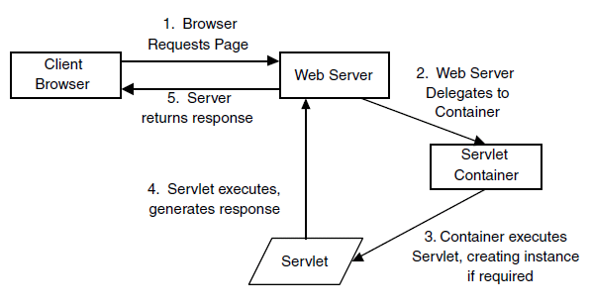
Basic Servlet Life Cycle

Slide 7
Servlet Life Cycle contd.
The lifecycle of a servlet is controlled by the container in which the servlet has been deployed
At the deployment time, each servlet is mapped to a certain URL pattern speciﬁed in the application’s deployment descriptor, called web.xml

Slide 8
Servlet Life Cycle contd.
When a request is mapped to a servlet, the container performs the following steps
If an instance of the servlet does not exist, the web container
Loads the servlet class
Creates an instance of the servlet class
Initializes the servlet instance by calling the init method
The container invokes the service method, passing request and response objects
If it needs to remove the servlet, the container finalizes the servlet by calling the servlet's destroy method

Slide 9
Servlet Types
Generic Servlet
Generic servlet is protocol independent servlet
It implements the Servlet and ServletConfig interface
It may be directly extended by the servlet
It has only init() and destroy() method of ServletConfig interface in its life cycle
It also implements the log method of ServletContext interface

Slide 10
Servlet Types contd.
Http Servlet
HttpServlet is HTTP (Hyper Text Transfer Protocol) specific servlet
It provides an abstract class HttpServlet for the developers to create their own HTTP specific servlets
The sub class of HttpServlet must overwrite at least one method given below
doGet() ,doPost(),doPost(),doTrace(),doDelete()
init(),destroy(),getServiceInfo()

Slide 11
service() method
All HTTP network requests have several “methods” of invocation that indicate the intent of the request
GET, POST, PUT, and DELETE
When a Servlet container first routes to a Servlet, it invokes the service() method
By default, the service() method will dispatch to doGet(), doPost(), doPut(), or doDelete() based on the method information given in the HTTP request header
You can override this default service() implementation to respond to all HTTP requests in an identical way

Slide 12
Get
Common form of HTTP request
The doGet() method receives an HttpServletRequest and an HttpServletResponse object
Must throw java.io.IOException and ServletException.
A simple implementation might look like this:
public void doGet (HttpServletRequest req, HttpServletResponse res)
throws ServletException, IOException {
res.setContentType("text/html");
PrintWriter out = res.getWriter();
out.println("Hello World");
}

Slide 13
Post
HTTP employs the POST method to transfer large amounts of HTML form data
If the Servlet’s service() method receives an HTTP POST request, the Servlet’s doPost() method is called
The input parameters are identical to doGet()
The doPost() method is sometimes chained to doGet()
public void doPost (HttpServletRequest req,
HttpServletResponse res) throws ServletException, IOException {
doGet(req, res);
}

Slide 14
Init and Destroy
The init and destroy methods identify the beginning and end of the Servlet life cycle
The init() method
Called when a Servlet is being placed into service by the container
The destroy() method
Called when the container takes the Servlet out of service
These methods are most often used to
Initalize and release resources
Provide other life cycle–sensitive support functions

Slide 15
ServletInfo
The getServletInfo() method can be overridden to provide information such as the Servlet author, company, copyright, or version
This method returns an empty string by default
Normally only called by other Servlets

Slide 16
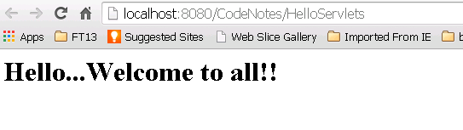
Servlet - Example
public class HelloServlets extends HttpServlet {
public void doGet (HttpServletRequest request, HttpServletResponse response) throws ServletException, IOException {
response.setContentType("text/html");
PrintWriter out = response.getWriter();
out.println("<html><body>");
out.println("<h1>Hello...Welcome to all!!</h1>");
out.println("</body></html>");
out.close();
}
}

Slide 17
Descriptor for HelloServlets
<servlet>
<servlet-name>HelloServlets</servlet-name>
<servlet-class>com.hello.HelloServlets</servlet-class>
</servlet>
<servlet-mapping>
<servlet-name>HelloServlets</servlet-name>
<url-pattern>/HelloServlets</url-pattern>
</servlet-mapping>
<session-config>
<session-timeout>
30
</session-timeout>
</session-config>

Slide 18
JSP Technology
HTML pages with embedded Java
In contrast to servlets (Java with embedded HTML )
Same performance and portability benefits from servlet technology but with the ease of use of HTML
Easier to develop the web application in more efficient way than Servlets
Best of both worlds for Web designers and Web developers
Enables separation of business logic from presentation

Slide 19
JSP Page Life Cycle
JSP pages are compiled into servlet classes before they are used to process requests
This compilation step is handled by the JSP container at runtime, or at deployment time if required
When a JSP is requested, the container looks for a Servlet class
If the class does not exist, or if the Servlet compile date is older than the last access date on the JSP, the JSP is compiled

Slide 20
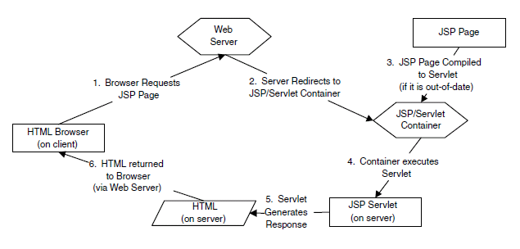
JSP Page Life Cycle contd.

Slide 21
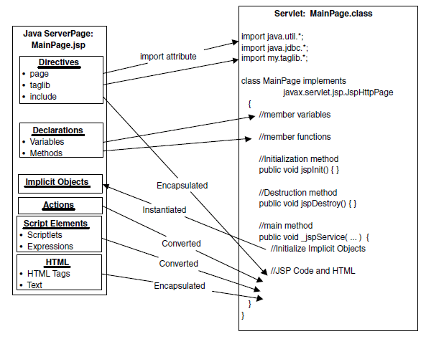
JSP Scripting Elements

Slide 22
Components of JSP
JSP page is built using components such as
Directives
In the directives we can import packages, define error handling pages or the session information of the JSP page
E.g.,
<%@page language="java" %>
<%@ include file="/header.jsp" %>
Declarations
Used for defining the functions and variables to be used in the JSP
Syntax of JSP Declaratives
<%!
//java codes
%>

Slide 23
Components of JSP contd.
Scriplets
We can insert any amount of valid java code
JSP Scriptlets begins with <% and ends with %>
Expressions
Use this tag to output any data on the generated pag.
These data are automatically converted to string and printed on the output stream
Syntax of JSP Expressions are:
<%="Any thing" %>
Example:
<%="Hello World!" %>
Above code will display 'Hello World!'

Slide 24
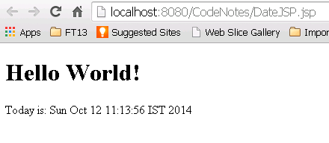
JSP - Example
Code
<html>
<head>
<title>JSP Page</title>
</head>
<body>
<h1>Hello World!</h1>
Today is: <%= new java.util.Date() %>
</body>
</html>
Output

Slide 25
Persistence API
The Java Persistence API (JPA) was introduced as part of the Java EE 5 platform.
Its goal is to facilitate data acquisition from relational databases without the complexity of numerous sql statements.
The idea is to use an object oriented approach to data storage.
Data is handled without the need to create deployment descriptors.
Instead annotations are used which are read by the container.

Slide 26
Persistence API- Alternative implementations of JPA
An implementor of the JPA is called : Persistence Provider (i.e. NetBeansGlassFish).
Some Concepts are explained and demonstrated using OpenJPA, an open source JPA implementation from Apache.
OpenJPA has been integrated with the Weblogic, WebSphere, and Geronimo application servers. The current version of OpenJPA at the time of writing is 1.0.1
If you're going to use a different setup, obviously you'll need to check out the documentation first (although the approach is mostly the same in most servers).
Note: Kodo was originally developed by SolarMetric, Inc in 2001. BEA Systems acquired SolarMetric in 2005, where Kodo was expanded to be an implementation of JPA (JSR 220)^{[2]} specification. In 2006, BEA donated a large part of the Kodo source code to the Apache Software Foundation under the name OpenJPA.

Slide 27
Java Transaction API-JTA
The Java Transaction API (JTA) is part of the J2EE platform.
The API gives you the ability to perform distributed transactions, that is, an application can use the API to perform transactions on more than one data store in the network at the same time.
But to do this efficiently, it helps to have another component operating in the application server: a J2EE transaction manager.
A transaction manager helps to efficiently schedule and execute the potentially large number of transactions coming in through the application server.

Slide 28
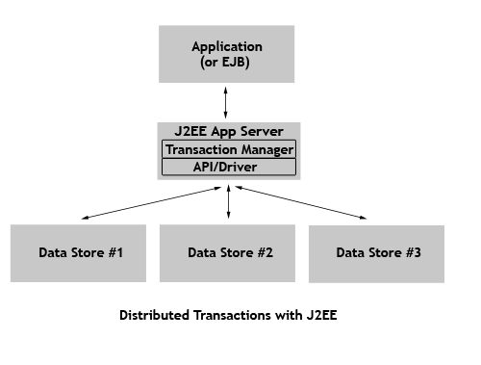

Slide 29
Java Transaction API
The data source must be registered on the server and is specified using the JNDI name.
Transactions can be:
Container Managed
Application Managed.
If the transactions are container-managed JTA transactions, the data source must be a JTA data source. This is the preferred way!
It must be specified in the decsriptor file persistence.xml

Slide 30
Java Transaction API
If the transactions are application-managed, the data source is specified according to the JDBC database connection registered with the IDE .
You use this approach if you are not deploying in a EE container (like GlassFish).

Slide 31
Persistence API-Entities
Entity
A table in a database.
An Entity is represented by a class
Instance of entity corresponds to a row in the database.
A number of rules cover the implementation of an entity class.
Note: The database is sometimes referred as: Data Source or Data Store

Slide 32
Persistence API-Entity Relationships
Relationships are the same as relationships between tables in a database:
One-To-One:
Each instance of the entity (row) is related to single instance of another entity (to a single row of another table).
One-To-Many:
An entity instance can be related to more than one instance of another entity. But an instance of the other Entity can only relate to one instance of the first.

Slide 33
Persistence API-Entity Relationships
Many-To-One:
Multiple instances (rows) of an Entity can be related to one instance of another Entity. But an instance of the other Entity can relate to only one instance of the first Entity.
Many-To-Many:
An instance of one Entity relates to many instances of another Entity and vice versa.
For every relationship there is an owning side and inverse side.
The relationship can be unidirectional –it has only an owning side.
Or, bidirectional – it ha s both an owning side and an inverse side.

Slide 34
Example Relationships
Authors
Owner
Titles
Inverse
Many To Many
bidirectional
Inverse
Inverse
Owner
One-To-Many
Bidirectional
One-To-Many
Bidirectional
Owner
Publishers

Slide 35
Summary
Servlet technology allows to develop Java applications that generate web content
JSP pages are compiled into servlet classes before they are used to process requests

